Slide 1

Architectural Layers of Cloud Computing
Topic 2

Slide 2
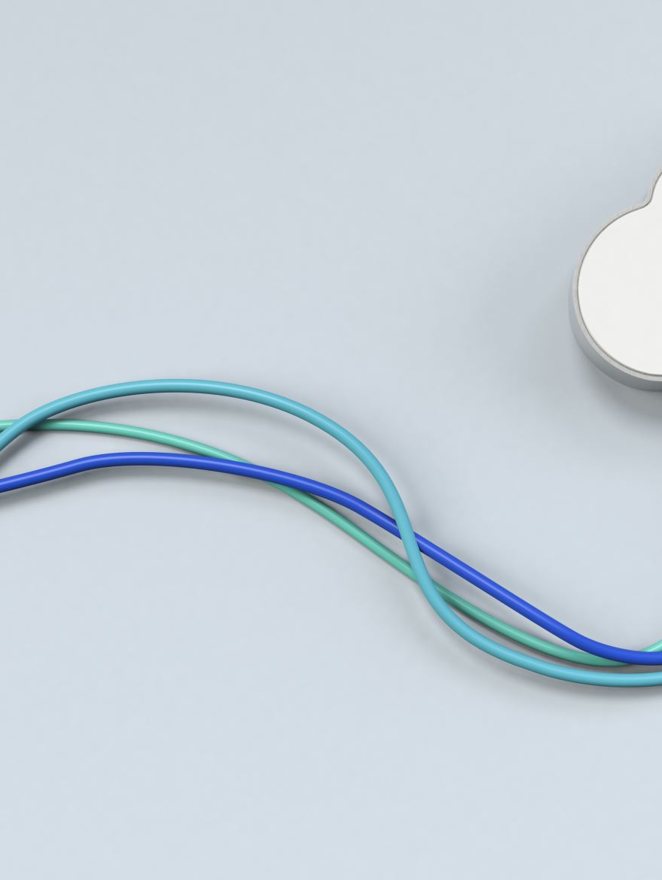
Contents
Introduction to Cloud Computing
Cloud Computing Layers
Software as a Service (SaaS)
Platform as a Service (PaaS)
Infrastructure as a Service (IaaS)
Dynamic Infrastructure
Summary & Q&A

Slide 3
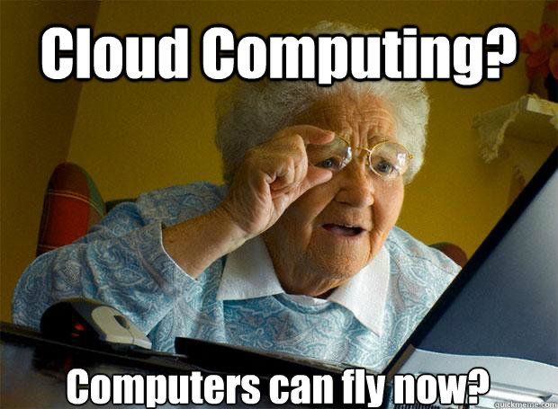

Slide 4
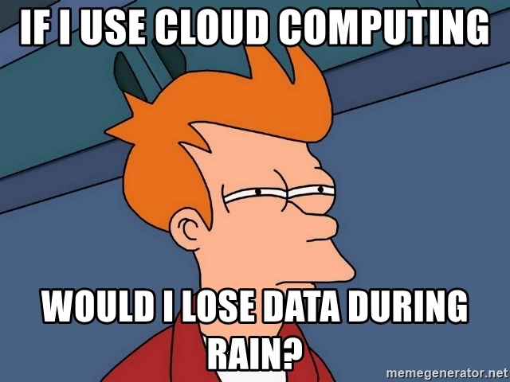

Slide 5
Introduction to Cloud Computing
Cloud computing is the on-demand delivery of computing services (servers, storage, databases, networking, software) over the internet.
Key Characteristics:
On-demand self-service
Broad network access
Resource pooling
Rapid elasticity
Measured service (pay-as-you-go)

Slide 6

Delivery of Computing Services
Servers
Storage
Databases
Networking
Software
Analytics
Artificial Intelligence

Slide 7
Why Cloud Computing?
Business Advantages:
Scalability for growing workloads
Cost-effective model (operational vs. capital expenses)
Faster deployment of new services
Global reach and availability
Technical Advantages:
Automated software updates
Simplified infrastructure management
Resilience and redundancy

Slide 8

Cloud Computing Layers
High-Level Layers in Cloud:
Infrastructure as a Service (IaaS)
Platform as a Service (PaaS)
Software as a Service (SaaS)
Goal: Abstract complexity for end users and businesses.

Slide 9

Understanding the Layered Model
Layered Approach:
Each layer builds upon the capabilities of the layer below.
Users at each layer only focus on resources they directly manage.
Analogy:
SaaS: The complete package (like using a fully-furnished apartment).
PaaS: The foundation to build upon (like an empty apartment where you bring your own furniture).
IaaS: The raw materials and space (like the land and building framework).

Slide 10

Software as a Service (SaaS)
Software distribution model in which applications are hosted by a third-party provider and made available over the internet.
Key Characteristics:
No local installation required
Subscription or pay-per-use pricing
Accessible via web browser or thin client
Examples:
Salesforce, Microsoft 365, Google Workspace (Gmail, Docs), Dropbox

Slide 11
SaaS – Benefits and Challenges
Benefits:
Quick deployment and minimal setup
Reduced IT overhead (maintenance, updates are handled by provider)
Access from anywhere, on multiple devices
Challenges:
Limited customization compared to on-premises software
Dependency on internet connectivity
Potential data privacy and compliance concerns

Slide 12
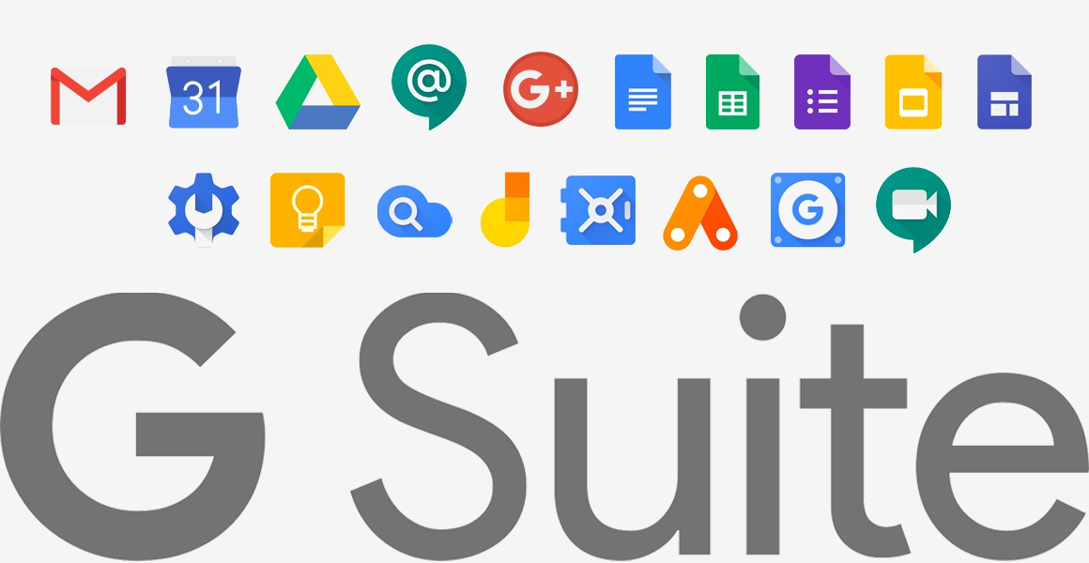
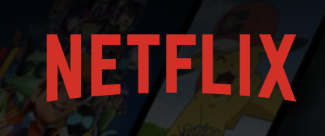


Software As A Service (SAAS)

Slide 13

Platform as a Service (PaaS)
A set of tools and services designed to make coding and deploying applications quick and efficient.
Providers manage the underlying infrastructure; developers focus on the application itself.
Key Components:
Runtime environment (language runtimes, frameworks)
Development tools
Databases and integration services

Slide 14
PaaS – Benefits and Challenges
Benefits:
Simplifies development and deployment
Less complexity in managing servers, storage, or networking
Automated scalability
Challenges:
Might be restricted to provider-specific tools/languages
Risk of “vendor lock-in”
Costs can grow if the application scales rapidly

Slide 15
Examples of PaaS Providers
Major PaaS Offerings:
Heroku (Salesforce)
Google App Engine (Google Cloud Platform)
Azure App Service (Microsoft Azure)
AWS Elastic Beanstalk (Amazon Web Services)
Key Services Offered:
Hosting environments
Integrated development environments (IDEs)
Database and storage integrations

Slide 16
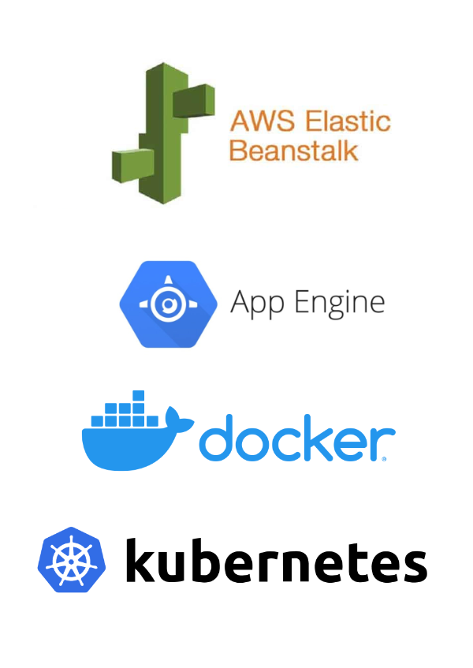
Platform As A Service (PAAS)

Slide 17
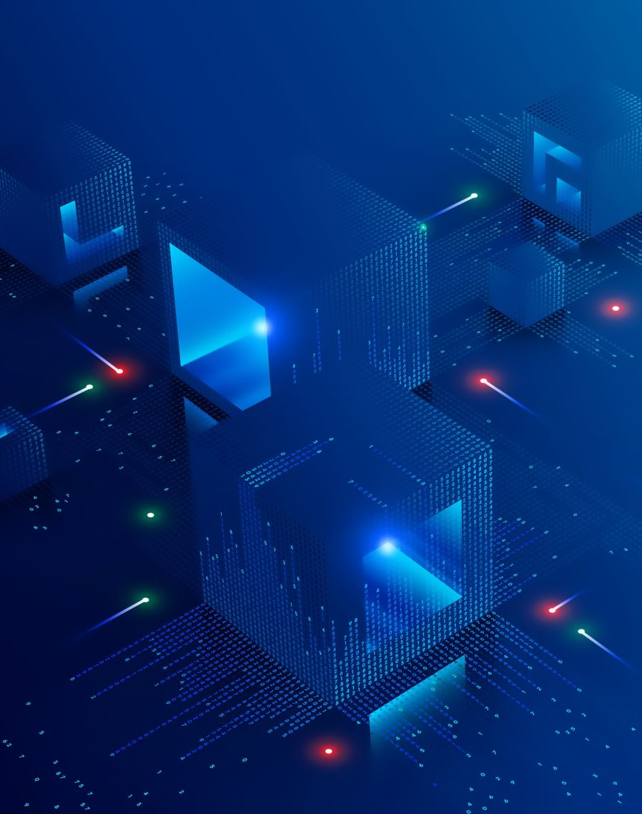
Infrastructure as a Service (IaaS)
Virtualized computing resources over the internet, including servers, storage, and networking hardware.
Users install and manage operating systems, applications, and middleware on provided infrastructure.
Key Components:
Virtual machines (VMs)
Storage (object, block, file)
Networking (virtual networks, firewalls, load balancers)

Slide 18
IaaS – Benefits and Challenges
Benefits:
High flexibility and control over resources
Pay-as-you-go model for infrastructure
Easy scalability and rapid provisioning
Challenges:
Requires in-house expertise to configure and manage
Security and compliance are partly the customer’s responsibility
Potential complexity in managing virtual machines and networks

Slide 19
IaaS Providers and Use Cases
Major IaaS Providers:
Amazon Web Services (EC2, S3, etc.)
Microsoft Azure (Virtual Machines, Azure Storage)
Google Cloud Platform (Compute Engine, Cloud Storage)
Typical Use Cases:
Hosting web applications
Big data processing
Backup and disaster recovery
Development and testing environments

Slide 20
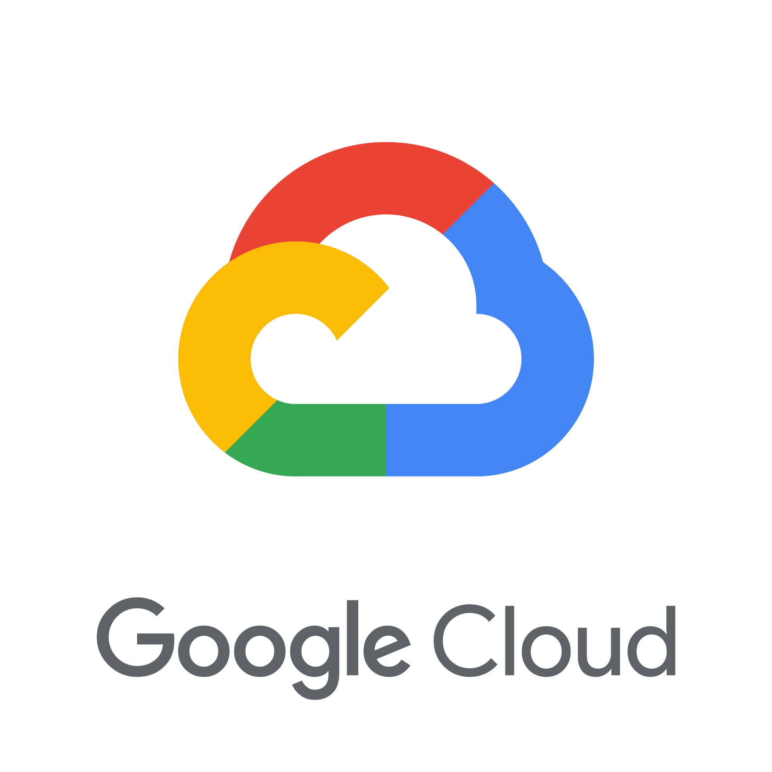

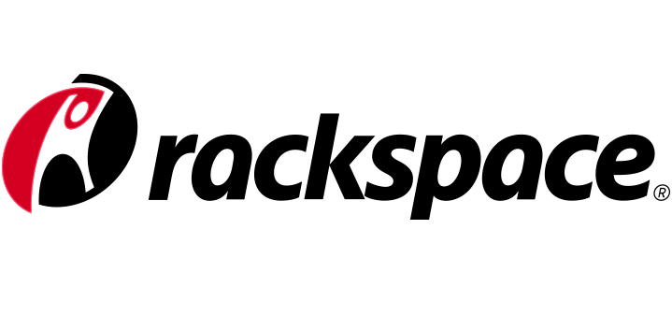
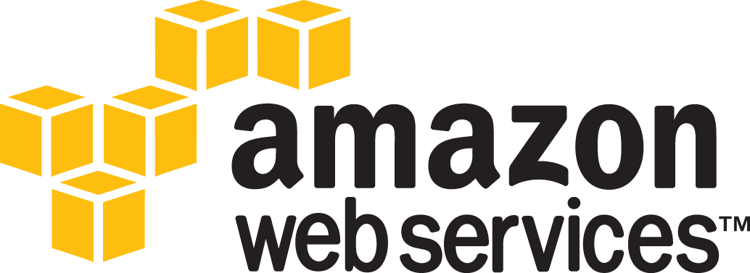

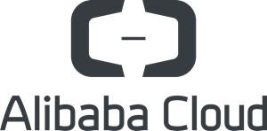
Infrastructure As A Service (IAAS)

Slide 21
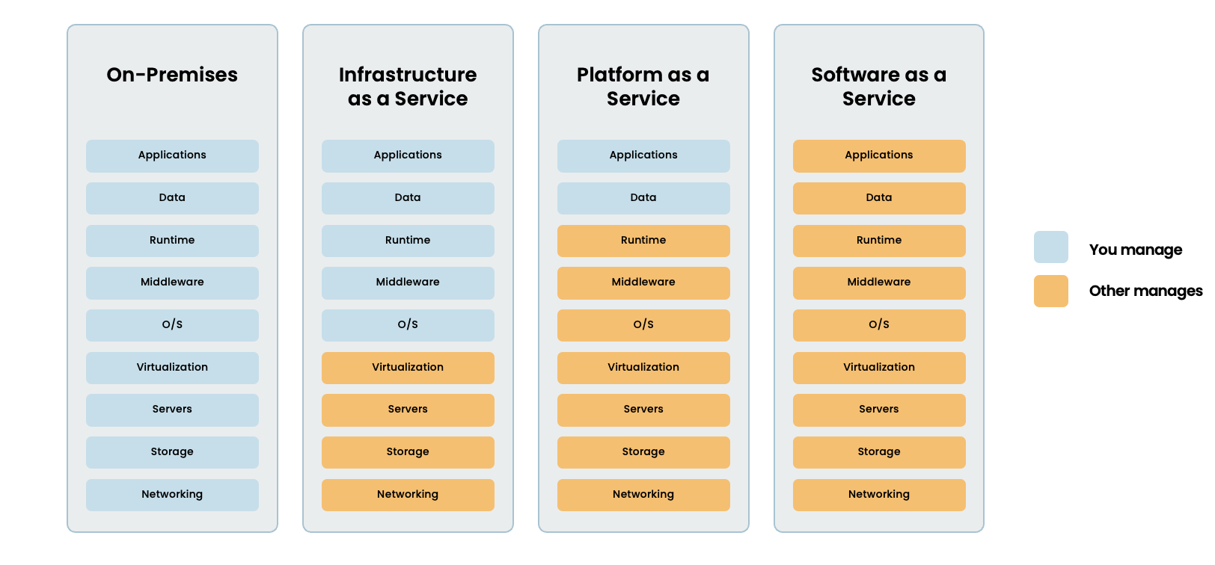

Slide 22
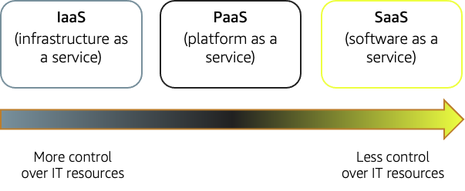

Slide 23
Dynamic Infrastructure
The ability to quickly adapt and reconfigure IT infrastructure resources as demands change.
Often enabled by virtualization, automation, and orchestration technologies.
Ensures optimal performance, cost efficiency, and high availability
Facilitates continuous integration and continuous deployment (CI/CD)

Slide 24
Key Components of Dynamic Infrastructure
Virtualization - Abstracts hardware into virtual resources (VMs or containers)
Automation - Scripts or tools to streamline provisioning, configuration, and scaling
Orchestration - Systems (like Kubernetes, Docker Swarm) that manage the lifecycle of multiple resources
Monitoring & Management - Tools to observe and adjust resource usage in real time (e.g., AWS CloudWatch, Azure Monitor)

Slide 25
Benefits of a Dynamic Infrastructure
Scalability
Easily add or remove resources in response to traffic or workload changes
Agility
Faster deployment of new applications and updates
Cost Optimization
Pay only for the resources actually in use
Fault Tolerance
Automatically shift workloads if a server or region fails

Slide 26
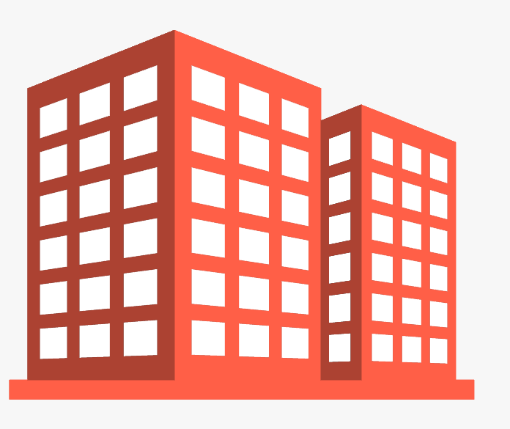
Izrulfizal Shoe Store
e-Commerce
HR System
CCTV
Financial System
HQ & Izrulfizal Shoe Store
Integrated SOP System
Business Monitoring

Slide 27
Izrulfizal Shoe Store
Traditional way:
- Weeks/months to setup the infrastructure
- Running business on paper
HQ & Izrulfizal Shoe Store

Slide 28
Izrulfizal Shoe Store
Modern way:
- Cloud hosting
- Server deployment in minutes
- Everything integrated
- Easy accessibility anytime
HQ & Izrulfizal Shoe Store

Slide 29
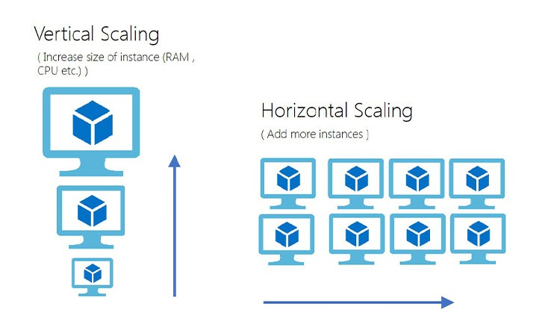

Izrulfizal Shoe Store
Heavy Traffics
Scalable
HQ & Izrulfizal Shoe Store

Slide 30
Challenges of Dynamic Infrastructure
Complexity
Multiple layers of abstraction can be difficult to manage
Skill Gap
Advanced knowledge required for automation/orchestration tools
Governance
Ensuring compliance and security policies in rapidly changing environments
Monitoring & Debugging
Dynamic scaling can make troubleshooting more complex

Slide 31
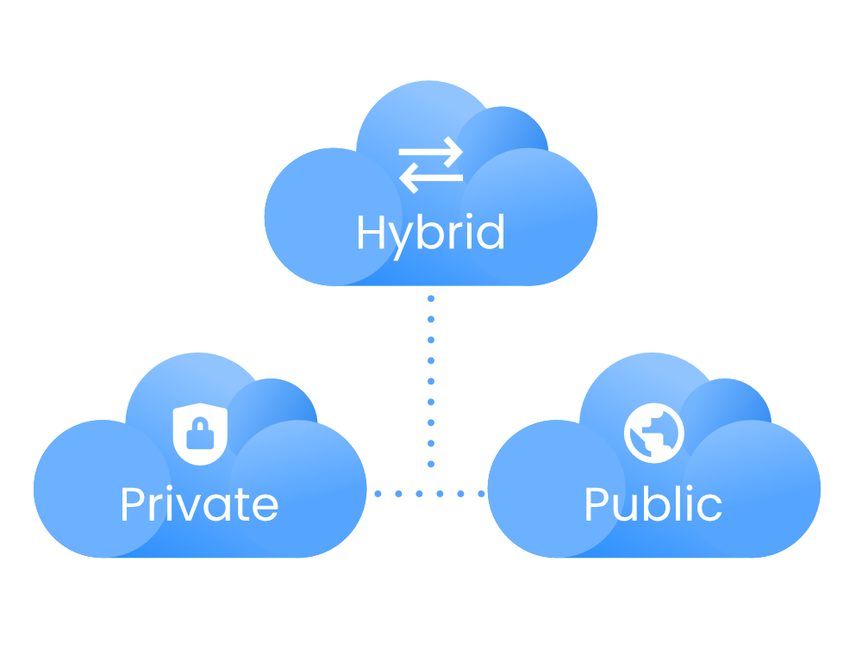
Type of Cloud Deployment
Another thing about Cloud Computing is how accessible it is. For this, we can differentiate cloud computing in three different ways :
Public Cloud
Private Cloud
Hybrid Cloud -
Mixture of Private & Public

Slide 32
Putting It All Together
Layered Approach Recap
SaaS: Complete software solutions provided to end users
PaaS: Platform that abstracts infrastructure and offers tools for development
IaaS: Core infrastructure (servers, storage, networking) delivered virtually
Dynamic Infrastructure - Underpins all these layers with flexibility and automation
Choosing the Right Model - Depends on your business needs, development expertise, and desired level of control

Slide 33

Summary
Cloud computing offers different service models (SaaS, PaaS, IaaS) to suit various needs.
Dynamic infrastructure enables scalability, agility, and cost-effectiveness.
Understand the trade-offs (control vs. complexity, cost vs. flexibility).

